Slide 1
Bloed, zweet en tranen
Gepresenteerd door: Alex, Naël, Romy en Celine

Slide 2
Inhoud
01
02
03
04
05
06
Opdracht
Ons idee
Game laten zien
Samenwerking
Toekomst
Einde

Slide 3
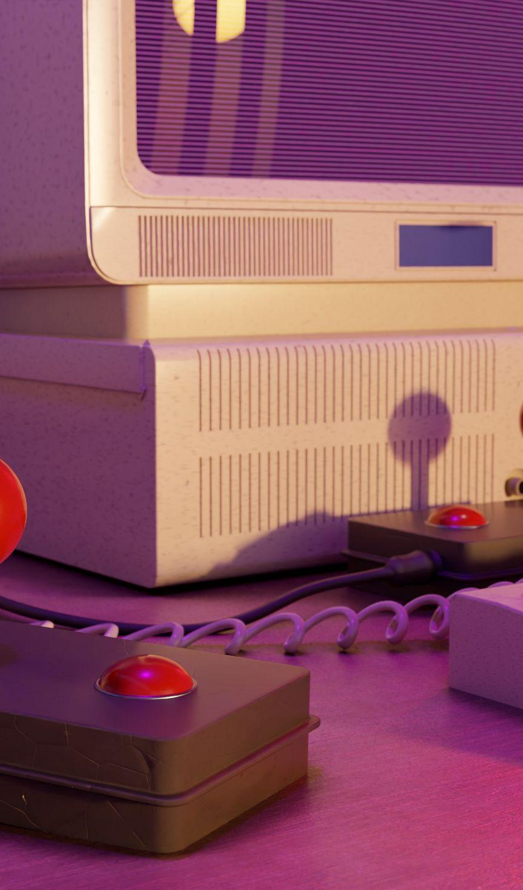
Opdracht
TechJam
Klant : Blast Galaxy
Doel: In een korte tijd iets ontwikkelen en nieuwe technieken proberen.
Samenwerken met 4 SD1-studenten
Laten zien wat we geleerd hebben periode 1 en 2

Slide 4
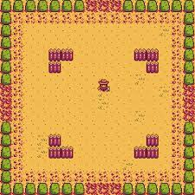
Ons idee
—Stardew valley Minigame
Lijken op deze minigame

Slide 5
03
Game laten zien

Slide 6
Samenwerking
Naël
Alex
“Our company is excited to announce the development of a new project that has been in development for months. This innovative idea is expected to revolutionize our work”
“The reach of our newsletter is limitless! Every day we have more and more subscribers who want to discover everything we have to tell. We even improved the design!”
Romy
Celine
“Our organization has been recognized for excellence in our field by receiving an award. This recognition reflects the hard work and dedication of all of our amazing collaborators”
“We have recently partnered with a nonprofit organization to provide support and resources to those in need. We believe it is important to be socially responsible”

Slide 7
Toekomst
TIME MANAGEMENT
SELF-CARE
“Break your day into smaller chunks and focus on one task at a time. Take short breaks in between to stay fresh”
“Make time for exercise, healthy eating, and hobbies outside of work to reduce stress and promote relaxation”
NETWORKING
COMMUNICATION
“Attend events, join professional organizations, and connect with others in your field on social media to expand your network”
“Be concise when communicating ideas, actively listen to feedback, and be open to constructive criticism”
LEARNING
GOAL-SETTING
"Attend workshops, read industry publications and take online courses to expand your knowledge base”
"Set clear goals. You can break them down into smaller steps, which in turn are achievable, and celebrate progress”

Slide 8
-Einde-
Bedankt voor het luisteren
Zijn er nog vragen?

